Slide 1
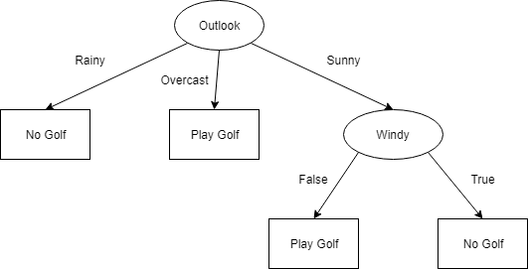
DECISION TREE

Slide 2
DECISION TREE ALGORITHM
Decision tree is a supervised type machine learning algorithm and it builds classification or regression models in the form of a tree structure.
The final result is a tree with decision nodes and leaf nodes.

Slide 3
In a Decision tree, there are two nodes, which are the Decision Node and Leaf Node.
Decision nodes are used to make any decision and have multiple branches, whereas Leaf nodes are the output of those decisions and do not contain any further branches.
A decision node has two or more branches.
Leaf node represents a classification or decision.
The topmost decision node in a tree which corresponds to the best predictor called root node.

Slide 4


Slide 5
ENTROPY
Entropy, as it relates to machine learning, is a measure of the randomness in the information being processed. The higher the entropy, the harder it is to draw any conclusions from that information.
Entropy is the measurement of impurities or randomness in the data points. It basically ranges between 0-1.
0- Pure, 1-Impure

Slide 6
WAY TO CREATE TREE IN DECISION TREE
Decision tree algorithm uses following 2 method to create the decision tree:
1. ID3 (Iterative Dichotomiser 3) → uses Entropy function and Information gain as metrics.
2. Gini Index or Gini impurity

Slide 7
WAY TO SELECT ROOT NODE IN ID3
1. Find the Information gain of the target attribute.
2. Find the Entropy of rest attributes.
3. Find gain for each and every rest attribute.
Gain = IG – Entropy
4. The attribute that has highest gain will be selected as root node.

Slide 8
INFORMATION GAIN
Information gain is the measurement of changes in entropy after the segmentation of a dataset based on an attribute.
It calculates how much information a feature provides us about a class.
According to the value of information gain, we split the node and build the decision tree.
A decision tree algorithm always tries to maximize the value of information gain, and a node/attribute having the highest information gain is split first. It can be calculated using the below formula:

Slide 9
GINI INDEX OR GINI IMPURITY
Gini Index - It measures the impurity of the nodes. ranges between 0-1.
Gini Index/Gini Impurity = 1-Gini
1 - (/Sum of squred propability of each class)
0 - Data points/feature are pure. Eg. All Yes
1 - Data points/feature are impure(Randomness) eg. Yes, No both
0.5 - Equal distribution of classes. 10 yes, 10 no

Slide 10
HOW TO SELECT ROOT NODE IN GINI INDEX?
Least Gini index is preffered as root node while making decision tree.
Gini works only in those scenarios where we have categorical targets. It does not work with continuous targets.
Higher value of gini more the purity of node
Less value of gini less pure node.

Slide 11
Pruning
It is one of the technique that is used to overcome problem of overfitting in decision tree.
Pruning is the process of reducing the size of the tree by turning some branch nodes into leaf nodes, and removing the leaf nodes under the original branch.
It reduces the size of a Decision Tree which might slightly increase training error but drastically decrease your testing error,hence making it more adaptable.

Slide 12
Types of pruning
Pre-pruning that stop growing the tree earlier, before it perfectly classifies the training set.
Post-pruning that allows the tree to perfectly classify the training set, and then post prune the tree.

